Slide 1

SILVERLINE CORPORATION | LOBBY ART COMMISSION
Confluence
An original three-panel mixed-media work for the Market Street headquarters lobby, on the theme of Philadelphia rivers and industry.
Concept presentation by Nancy Crawford. Commission fee $9,000. Delivery and installation December 4, 2026.

Slide 2

THE BRIEF
A calm anchor for the lobby
A single, considered work to greet staff and visitors at Market Street.
Quiet and durable, not decorative noise. A piece people pass daily for years.
Rooted in Philadelphia: the meeting of rivers, industry, and light.
Scaled to the lobby wall as a horizontal set of three panels.
Confluence | Nancy Crawford for Silverline Corporation
2 / 10

Slide 3
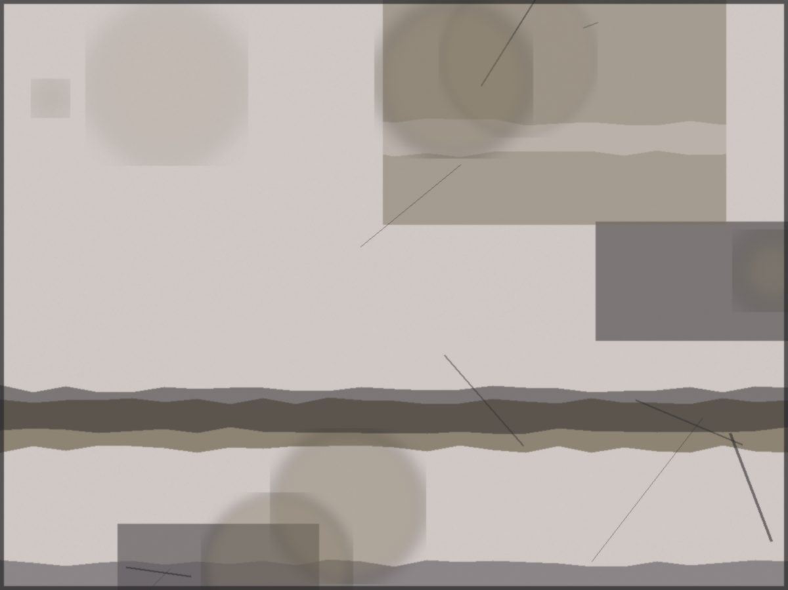
CONCEPT
Confluence, where the waters meet
The Schuylkill and the Delaware meet below the city. Confluence reads that meeting as three movements across three panels: the upstream register, the turning, and the open tide. Industry appears as trace, not subject: rolled steel, rivet marks, and the soft rust the riverfront leaves on everything it touches.
Panel 1
Panel 2
Panel 3
Confluence | Nancy Crawford for Silverline Corporation
3 / 10

Slide 4
THE THREE PANELS
Read left to right
Panel 1, Upstream
Cooler greys and slate, vertical marks. The quiet source.
Panel 2, The turning
Warmer centre, the rust seam, where the two waters fold together.
Panel 3, Open tide
Lighter and wider, horizontal light opening toward the river mouth.
Confluence | Nancy Crawford for Silverline Corporation
4 / 10

Slide 5
MATERIALS AND PALETTE
Built to last in a public space
Mixed media on sealed birch panel, cradled for depth.
Archival monotype, collage, and found riverfront material.
Matte conservation varnish, stable under lobby lighting.
Cleated French hanging system, concealed and secure.
Slate
River blue
Mist
Rust
Paper
Confluence | Nancy Crawford for Silverline Corporation
5 / 10

Slide 6
DIMENSIONS AND HANGING
Scaled to the lobby wall
Panel 1
Panel 2
Panel 3
48 in H x 36 in W
48 in H x 36 in W
48 in H x 36 in W
Overall set, hung with a 3 inch reveal between panels: 48 inches high by 114 inches wide. Centre line at 60 inches from the floor. Final wall measurement to be confirmed on site before install.
Confluence | Nancy Crawford for Silverline Corporation
6 / 10

Slide 7
FABRICATION TIMELINE
From approval to install
Jan 2026
Agreement signed, deposit received, maquette approved.
Oct 2026
Panels fabricated and surfaces built in studio.
Nov 2026
Sealing, varnish, and final photography.
Dec 4, 2026
Delivery and installation at Market Street.
Confluence | Nancy Crawford for Silverline Corporation
7 / 10

Slide 8
COMMISSION SUMMARY
Fees and schedule, in US dollars
Total commission fee
$9,000
Deposit on signing, 40%
$3,600
Balance on delivery
$5,400
Deposit of $3,600 received January 20, 2026. Balance of $5,400 due on delivery and installation. Scope changes after maquette approval are billed at $65 per hour, agreed in writing in advance.
Confluence | Nancy Crawford for Silverline Corporation
8 / 10

Slide 9
OWNERSHIP AND CARE
After installation
On payment of the balance, Silverline owns the physical work and may display it at the headquarters.
The artist retains copyright and the right to reproduce images for portfolio, press, and exhibition history, with credit.
Dust gently with a soft dry cloth. Keep out of direct sunlight and away from vents.
The artist is available for one conservation check within the first year, by arrangement.
Confluence | Nancy Crawford for Silverline Corporation
9 / 10

Slide 10
Confluence
I would welcome your notes on this concept. One round of maquette revisions is included before fabrication begins.
Nancy Crawford | nancy.crawford@finthesiss.ai | nancycrawford.com

